Slide 1


JCDecaux’s contribution to the United Nations Sustainable Development Goals (SDGs)
2025 edition, 2024 data

Slide 2

GREAT INFLUENCE,
GREAT RESPONSABILITY
12.000
850M+
80+
FTE* EMPLOYEES
PEOPLE - OUR DAILY AUDIENCE
COUNTRIES
3.900
2.600+
160
Close to
Close to
CITIES WITH 10.000+ INHABITANTS WITH JCDECAUX FURNITURE
SHOPPING MALLS AND SUPERMARKETS WITH JCDECAUX FURNITURE
AIRPORTS WITH JCDECAUX FURNITURE
*FULL TIME EQUIVALENT

Slide 3
UNDERSTANDING OUR CONTRIBUTION TO THE SDGs
1
INTRODUCING THE SUSTAINABLE DEVELOPMENT GOALS
2
THE TARGETS THAT JCDECAUX CONTRIBUTES TO
3
OUR CONTRIBUTION TO EACH SDG

Slide 4
INTRODUCING THE SUSTAINABLE DEVELOPMENT GOALS

Slide 5



The SDGs were adopted by the 193 Member States of the United Nations in 2015.
They are a global call to action to eradicate poverty, protect the planet and ensure that all human beings live in peace and prosperity by 2030, with milestones in 2020 and 2025.
Universal, inclusive and interconnected, these 17 goals - composed of 169 sub-targets not equally distributed among each of the SDGs – are a call to action by all (states, companies, cities, citizens, etc.) and establish a universal common language. The SDGs are a reference framework, a tool for raising awareness, a source of economic opportunities and a lever for multi-stakeholder collaboration.
Source: ONU

Slide 6
THE TARGETS THAT JCDECAUX CONTRIBUTES TO

Slide 7
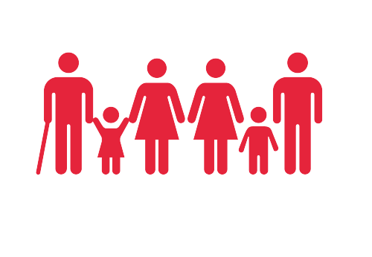






JCDecaux is contributing to several targets for each SDG.
Find out more about them below.
4.3: Ensure an equal access for all women and men to affordable and quality education
SDG 1: No poverty
1.2: Reduce at least by 50% the proportion of people living in poverty
1.3: Implement nationally social protection systems and measures for all
SDG 3: Good Health and well-being
3.4: Reduce non-communicable diseases and promote mental health and well-being
3.6: Halve the number of global deaths and injuries from road traffic accidents
3.9: Reduce the number of deaths and illnesses from environmental causes
SDG 4: Quality education
4.3: Ensure equal access for all women and men to affordable and quality education
4.4: Substantially increase the number of people who have relevant skills, for employment
4.7: Ensure that all learners acquire the knowledge and skills needed to promote sustainable development
SDG 5: Gender equality
5.1: End all forms of discrimination against all women and girls everywhere
5.5: Ensure women’s full and effective participation and equal opportunities for leadership
SDG 6: Clean water and sanitation
6.2: Ensure access to adequate and equitable sanitation and hygiene for all
6.3: Improve water quality by reducing pollution, eliminating dumping and minimizing release of hazardous chemicals and materials
6.4: Substantially increase water-use efficiency across all
SDG 7: Affordable and clean energy
7.2: Increase substantially the share of renewable energy in the global energy mix
7.3: Double the global rate of improvement in energy efficiency
SDG 8: Decent work and economic growth
8.1: Maintain economic growth in the least developed countries
8.5: Achieve full and productive employment and decent work for all women and men
8.7: Take measures to eradicate forced labour, child labour end modern slavery and human trafficking
8.8: Protect labour rights and promote safe and secure working environments for all workers, including migrant workers

Slide 8

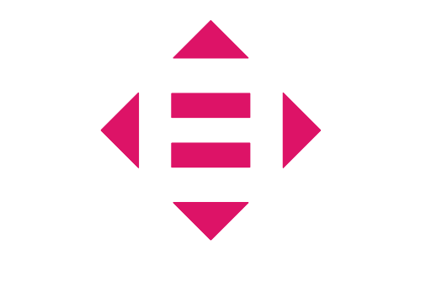
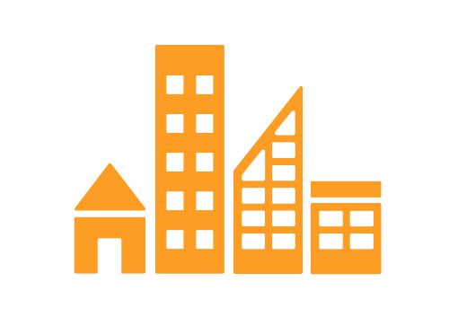
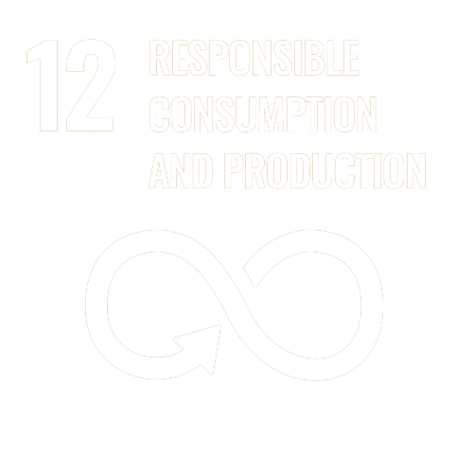
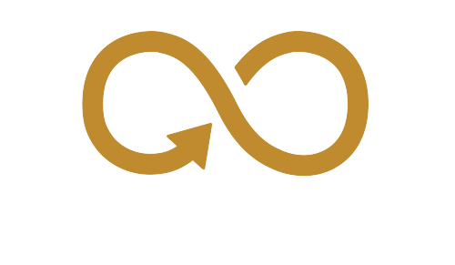



SDG 9: Industry, innovation, and infrastructure
9.1: Develop quality, reliable, sustainable and resilient infrastructure
9.c: Significantly increase access to information and communications technology
SDG 10: Reduced inequalities
10.2: Empower and promote the social, economic and political inclusion of all
10.3: Ensure equal opportunity and reduce inequalities of outcome
SDG 11: Sustainable cities and communities
11.2: Provide access to safe, affordable, accessible and sustainable transport systems for all
11.3: Enhance inclusive and sustainable urbanization
11.4: Protect and safeguard the world’s cultural and natural heritage
11.7: Provide universal access to safe, inclusive and accessible, green and public spaces
SDG 12: Responsible consumption and production
12.2: Achieve the sustainable management and efficient use of natural resources
12.5: Substantially reduce waste generation through prevention, reduction, recycling and reuse
12.8: Ensure that people have the relevant information and awareness for sustainable development
SDG 13: Climate action
13.2: Integrate climate change measures into national policies
13.3: Improve education, awareness-raising and human and institutional capacity on climate change
SDG 16: Peace, Justice, and strong Institutions
16.2: End abuse, exploitation, trafficking and all forms of violence against and torture of children
16.3: Promote the rule of law at the national and international levels and ensure equal access to justice for all
16.4: Significantly reduce illicit financial and arms flows
16.5: Substantially reduce corruption and bribery
16.10: Ensure public access to information and protect fundamental freedoms
16.b: Promote and enforce non-discriminatory laws and policies for sustainable development
SDG 17: Partnerships for the goals
17.16: Enhance the global partnership for sustainable development, complemented by multi-stakeholder partnerships

Slide 9
OUR CONTRIBUTION
TO EACH SDG

Slide 10

We contribute to all 17 Sustainable Development Goals, and to 6 in particular, in order to accelerate their promotion and development throughout the world.
Addressing the SDGs is a lever for innovation, enabling us to offer ever more responsible products and services.​

Slide 11
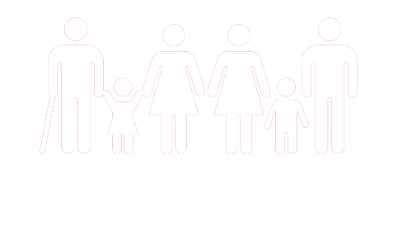

SDG 1 - End poverty in all its forms everywhere
Our "International Charter of Fundamental Social Values", available in 19 languages and deployed across the Group since 2012, describes our commitment to respect human rights, and strengthens the protection of fundamental social rights for all employees, particularly regarding rights to a decent wage, paid leave and social security. We make sure all our subsidiaries comply with the principles of our Charter through a survey held every other year.
100%
OF COUNTRIES RESPECT THE GROUP’S FUNDAMENTAL SOCIAL VALUES
See more

Slide 12

SDG 2 - Zero hunger
88
In 2024, we displayed campaigns
internationally, to fight hunger.
See more

Slide 13

SDG 3 - Ensure healthy lives
and promote well-being for all at all ages
-25%
We develop enhanced Street Furniture that helps measure air quality, traffic levels, pedestrian flows, etc. This provides cities with valuable data to understand and improve their citizens’ well-being. Our installations include Chicago, Cannes, Nice and Tokyo, among other cities.
IN ACCIDENT FREQUENCY RATE BY 2030
(VS 2019)
DEFIBRILLATORS
Our Health and Safety Policy aims to ensure the health and the safety of our employees, partners and the public. We continuously strengthen our policies and procedures to ensure our employees’ safety. This is achieved through employee training, accident investigations and our guarantee of the safety of our assets. We also require all subcontractors to sign our detailed Health & Safety contract and include all subcontracted operations into our inspection programme.
INTEGRATED IN OUR STREET FURNITURE ARE DEPLOYED IN CITIES
SENSORS
CAN BE ADDED TO OUR STREET FURNITURE TO MONITOR POLLUTION LEVELS IN CITIES
See more

Slide 14

SDG 4 - Ensure inclusive and equitable quality education and promote lifelong learning opportunities for all
81%
Since 2019, through our internal digital learning platform - JCDecaux Academy, our online training has been accessible to nearly 10,000 learners in 80+ countries. This training is tailored to meet our business needs, the Group’s evolution, our ethical, social, stakeholder and environmental commitments, and includes content about our sustainable development.
OF EMPLOYEES COMPLETED AT LEAST ONE TRAINING COURSE IN 2024
32.657 HOURS
We recruit interns and apprentices, enabling them to acquire professional skills and gain access to a secure and safe job.
OF TRAINING ON THE JCDECAUX ACADEMY, IN 2024
See more

Slide 15

SDG 5 - Achieve gender equality
and empower all women and girls
40%
OF WOMEN IN EXECUTIVE MANAGEMENT COMMITTEES BY 2030
Since January 2021, we have deployed a plan to increase the number of women in our Executive Management Committees (the “Gender Balance Plan”),
acting both on the company’s culture and the management of the appointment processes, to improve the representation of women at the highest levels of the company.
We are committed to ensure equal treatment of women and men at work, regarding hiring, compensation and career progression.
See more

Slide 16

SDG 6 - Ensure access to water and sanitation for all
N°1
SINCE 1980
Provider of public sanitation in the world
WE HAVE PROVIDED SELF-MAINTAINING PUBLIC TOILETS THAT ARE ACCESSIBLE TO ALL
+1.390
RAIN WATER
PUBLIC TOILETS IN 27 COUNTRIES IN 2024, REGISTERING +30 MILLION USES PER YEAR
IS USED TO WASH OUR STREET FURNITURE
WHENEVER POSSIBLE
The methods for washing street furniture and vehicles are reviewed regularly to reduce the quantity of water required while ensuring high washing quality.
We ensure that all our hazardous waste and WEEE (waste of electric and electronic equipment) are processed in specialised facilities and not discharged into wastewater.
See more

Slide 17
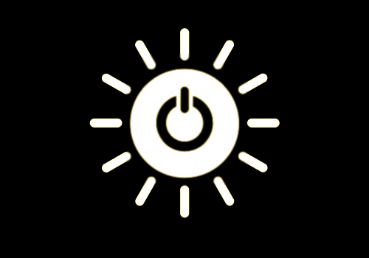
SDG 7 - Ensure access to affordable, reliable, sustainable and modern energy
In 2019 we became the first Out-of-Home company to join the RE100*and are taking action to reduce our energy consumption and carbon emissions through a number of key drivers. These include energy efficiency measures in the design and operation of our street furniture and by offsetting emissions related to electricity consumption through the purchase of green energy and by offsetting carbon.
-45%
OF ELECTRICITY CONSUMPTION FOR LCD DIGITAL SCREENS (IN THE LAST 10 YEARS)***
100%
We have defined lighting standards based on LED technology for our analogue street furniture, whether new or already in place, allowing us to reduce electricity consumption by more than 60%**.
OF GROUP’S ELECTRICITY CONSUMPTION COVERED BY ELECTRICITY FROM RENEWABLE SOURCES SINCE 2022
*International coalition, led by the NGOs The Climate Group and CDP, bringing together more than 360 companies committed to 100% renewable electricity production.
** Thanks to LED, dimming from 10pm to 1am and switch-off from 1am to 6am (vs. 2013 reference year with LED technology)
*** With local dimming, automatic modulation and switch-off from 1 a.m. to 6 a.m.
See more

Slide 18
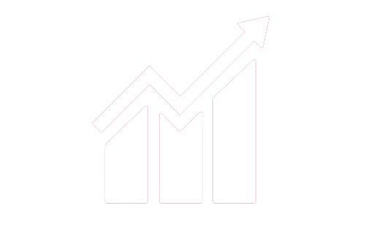
SDG 8 - Promote inclusive and sustainable economic growth, employment and decent work for all
N°1
Through our International Charter of Fundamental Social Values and our Code of Conduct of Suppliers, we uphold social principles such as the right to a decent wage and condemn child labour and forced or compulsory labour.
PROVIDER IN THE WORLD OF STREEET FURNITURE
We promote a rigorous health and safety culture that is adapted to our range of roles and activities.
95.5%
Since our company’s foundation in 1964, we have always had strong policies in place to support job retention, job creation and recruitment on permanent contracts. In 2024, 12.026 FTE* employees worked for the Group.
OF EMPLOYEES ON PERMANENT CONTRACTS IN 2024
+61%
Our activities and the value they create contribute to GDP growth. Worldwide, in 2022, there was €6.3Md of wealth creation. For 1€ of direct added value from JCDecaux, an additional 2.9€ are generated. The multiplier coefficient is therefore 3.9.
IN WORKFORCE BETWEEN 2001 AND 2024
*FTE : Full Time Equivalent
See more

Slide 19

SDG 9 - Build resilient infrastructure, promote sustainable industrialization and foster innovation
Quality, aesthetics, functionality and environmental performance are the primary characteristics of our designs. We fight against planned obsolescence by promoting sustainability and the circular economy.
At the end of its life, furniture can be upcycled and reused for new contracts.
100%
OF R&D TEAMS AWARE OF RESPONSIBLE INNOVATIONS IN LINE WITH THE SDGS, SINCE 2022
Through our new digital products, including our advertising and service screens, we are playing our role as “City Partner” to the fullest, helping to create the city of tomorrow by enhancing the passenger experience in transport environments such as airports and metros etc).
See more

Slide 20
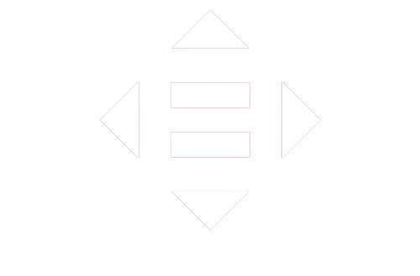
SDG 10 - Reduce inequality within and among countries
100%
OF COUNTRIES HAVE ROLLED OUT THE DIGITAL TRAINING ON GROUP’S VALUES “ETHICAL AND SOCIAL PRINCIPLES & SUPPLIER RELATIONS: I COMMIT!”
We fully support to the "Manifesto for the inclusion of disabled people in economic life" and are committed to facilitating access to employment for people with disabilities without discrimination and to creating favorable conditions for their recruitment and integration. We want to welcome people with disabilities, providing access to our sites and opening up access to recruitment interviews as well as by raising awareness among all our employees to combat stereotypes and discrimination.
We aim to create working conditions in which all employees can thrive and fulfil their potential. This is reflected in particular in a policy of non-discrimination in recruitment, remuneration, access to training and career management, which is a core constituent of our International Charter of Fundamental Social Values.
We promote the autonomy of all users by facilitating their mobility (bus shelters, self-service bicycles) and their access to technology, including the Internet through our free Wi-fi services.
We create street furniture that is accessible to all and develop services for people with disabilities (call buttons, labels with raised lettering, audible information, etc.)
See more

Slide 21
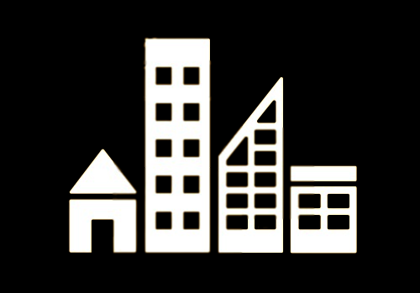
SDG 11 - Make cities inclusive, safe, resilient
and sustainable
We make everyday life easier for citizens by designing street furniture that is useful, innovative, accessible to all, comfortable, safe and sustainable. They can have several lives, guarantee a quality of service, and are renovated on site to extend their lifespan.
30 YEARS
AVERAGE LIFESPAN FOR OUR STREET FURNITURE
Our shelters and self-service bicycles increase eco-mobility with the use of public transport and bicycles in the city.
50%
Almost
Our street furniture and billboards are designed to withstand challenging temperature and weather conditions, and we carry out rigorous resistance tests. We support the press through our news kiosks and facilitate the display of public information and cultural messaging across our street furniture.
OF GROUP REVENUES ARE ALIGNED WITH CLIMATE CHANGE MITIGATION OBJECTIVE**
The Green Taxonomy is a common framework implemented by the European Commission. The goal is to prioritise the financing of activities that already contribute significantly to the low-carbon transition objectives. We have 3 eligible activities* at JCDecaux: bus/tram shelters, self-service bicycles and their stations/docks, and the financing of land transport.
* 49,3% of 2024 adj. revenues are Taxonomy-eligible, i.e. in the scope of sustainable activities identified by the EU.
** 2023 adjusted data. Alignment implies a recognised positive impact to low-carbon transition.
See more

Slide 22
SDG 12 - Ensure sustainable consumption
and production patterns
100%
Our Code of Conduct of Suppliers makes clear the standards we expect from our suppliers in terms of social responsibility, ethics, health and safety and the environment helping JCDecaux to reduce our impact throughout our value chain. We conduct assessments and audits of our key suppliers to ensure that the principles set out in this Code are being properly applied. (2024 performance: 100% of our key suppliers signed the Code and all of them have been assessed).
OF COUNTRIES ARE COMMITED TO IMPLEMENTING THE PRINCIPLES OF THE CODE OF CONDUCT FOR OUT-OF-HOME DISPLAY​
0%
We believe JCDecaux and Out-of-Home can be the catalyst for responsible and respectful communication, promoting information that supports the values and principles of sustainable development.
WASTE LANDFILLED BY 2035
VS IN COUNTRIES WITH SUITABLE FACILITIES
97%
We reduce our waste particularly through an eco-design approach to our street furniture, allowing us to develop products while anticipating the separability of the materials and so increasing their recyclability at end of life. We have developed the upcycled bus shelter, which allows a reduction of about 60% of CO2 eq, compared to a new passenger shelter, thanks to used materials.
WASTE RECOVERED IN 2024
See more

Slide 23
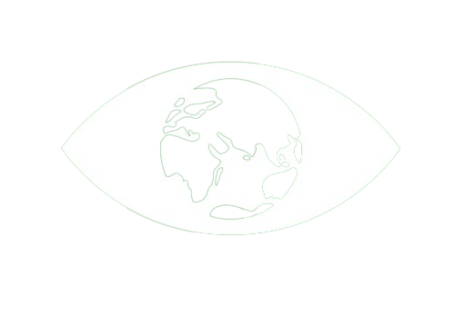
SDG 13 - Take urgent action to combat climate change and its impacts
-28.3%
In 2023, JCDecaux launched its Climate Strategy. Defined at the Group level, it defines our commitments through an ambitious policy aligned with the Paris Agreement, aimed at achieving Net Zero carbon by 2050. Our reduction trajectory was validated by the Science Based Targets initiative (SBTi) in 2024.
OF GREENHOUSE GAS EMISSIONS IN 2024
VS 2019 (IN KT CO2 EQ*) ​
OUR CLIMATE STRETEGY TRAJECTORY:
In response to growing demand from our customers, to sensibilize them to the impact of their OOH advertising campaigns, we have developed the ‘360 Footprint’ tool, which takes into account the economic, social and environmental footprints of campaigns. It's the first four-indicator calculator (carbon, water, jobs supported, and wealth generated) for outdoor advertising. Available in France since 2022, we are starting to roll it out internationally in 2025.
-73% and -46%
REDUCTION IN CARBON EMISSIONS BY 2030,
RESPECTIVELLY ON SCOPES 1 + 2, AND SCOPE 3
-90%
We enable cities such as Helsinki or Colmar to keep their citizens informed about air quality. By integrating sensors into street furniture in cities, such as Chicago, Nice and Tokyo.
REDUCTION IN CARBON EMISSIONS BY 2050,
ON SCOPES 1, 2, 3
​*SCOPES 1, 2 & 3 (MARKET-BASED)​
See more
Notes:
We enable cities such as Helsinki or Colmar to keep their citizens informed about air quality. By integrating sensors into street furniture in cities, such as Chicago, Nice and Tokyo we provide granular air quality measurements.

Slide 24

SDG 14 - Conserve and sustainably use the oceans, seas and marine resources
28
In 2024, we displayed campaigns
internationally, to conserve marine life
See more

Slide 25

SDG 15 - Sustainably manage forests, combat desertification, halt and reverse land degradation, halt biodiversity loss
300
In 2024, we displayed campaigns
internationally, for earthy life.
See more

Slide 26

SDG 16 - Promote peaceful and inclusive societies
100%
OF CONNECTED EMPLOYEES SIGNED THE CODE OF ETHICS IN 2024
Published in 2001, our Code of Ethics formalises the rules of business conduct applicable to all Group employees with our customers, landlords and suppliers/service providers. It highlights three Fundamental Rules of Ethics relating to the prevention and fight against corruption and undue influence, the prohibition of anti-competitive practices and the obligation of accuracy and transparency in accounting and financial areas. It includes an alert procedure that is available to all employees.
We protect fundamental freedoms by condemning child labour, promoting the rule of law, the right to collective bargaining, the right to paid leave, and fighting discrimination.
Created in 2018, the Group Vigilance Committee, an internal governance committee, is responsible for developing and implementing the annual Vigilance Plan, and for investigating any alerts received via the alert procedure.
Through our powerful public displays, we can play a leading role in promoting responsible communication on subjects of public interest (e.g. health, charitable causes, global warning etc).
See more

Slide 27
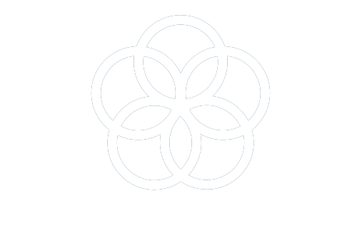
SDG 17 - Revitalize the global partnership
for sustainable development
We know that our media has the power to shape public opinion and so we support a number of important causes. These causes include: road safety, the environment, support for disadvantaged groups, and raising awareness of the plight of endangered species. Our commitment is shown through our free-of-charge advertising displays, financial support and by creating campaigns with local partners, agencies, governments etc to raise awareness and promote solutions to social, societal and environmental issues.
OFFICIAL PARTNER
OF THE UNITED NATIONS FOR THE PROMOTION OF THE SDGS, SINCE 2022
57
GROUP’S COUNTRIES IMPLEMENTED SPECIFIC SUPPORT ACTIONS FOR MAJOR CAUSES, IN 2024
Here are some of the major causes that JCDecaux supports:
Since 2014, we have been a partner of Justdiggit, an association that works for the re-greening of Africa. We support the fight against suicide by CALM (Campaign Against Living Miserably) in the United Kingdom. We also support the fight against climate change and the preservation of fauna and flora with the German foundation for the preservation of wild animals (Deutsche Wildtier Stiftung) in Germany.
The promotion of these important campaigns represented 2% of the Group’s advertising revenue in 2024.
3.000+
MAJOR CAUSES CAMPAIGNS DISPLAYED IN 2024
See more

